Slide 1

Social Determinants of Health: Smoking and Poverty
Biostatistics Final Project
Gracie Geddie
University of Dallas
4 December 2023

Slide 2
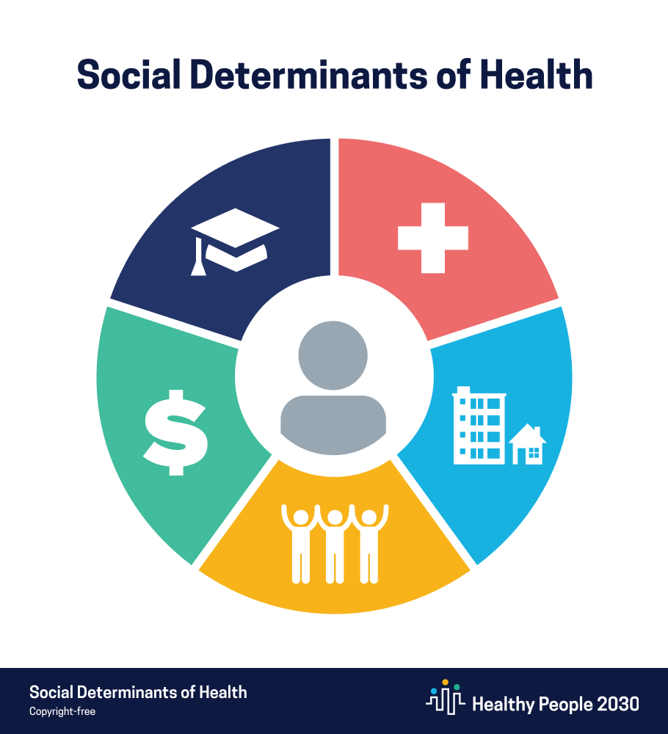
Social Determinants of Health
Defined as the conditions in the environment…that affect a wide range of health, functioning, and quality-of-life outcomes and risks.
Conditions may fall under several categories

Slide 3
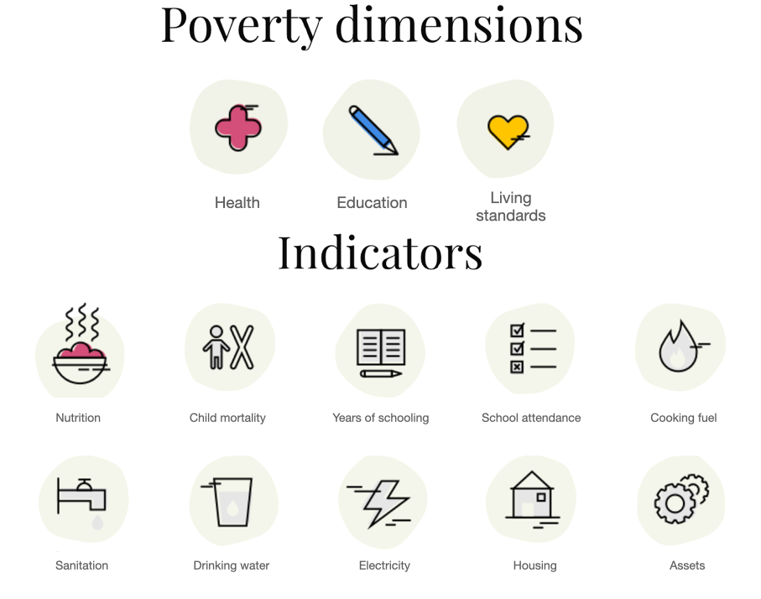
Poverty
Poverty affects health in a myriad of ways, from decreased access to healthcare, unsafe living conditions, and increased exposures to harmful elements.
Poverty can be defined and assessed in several ways.

Slide 4
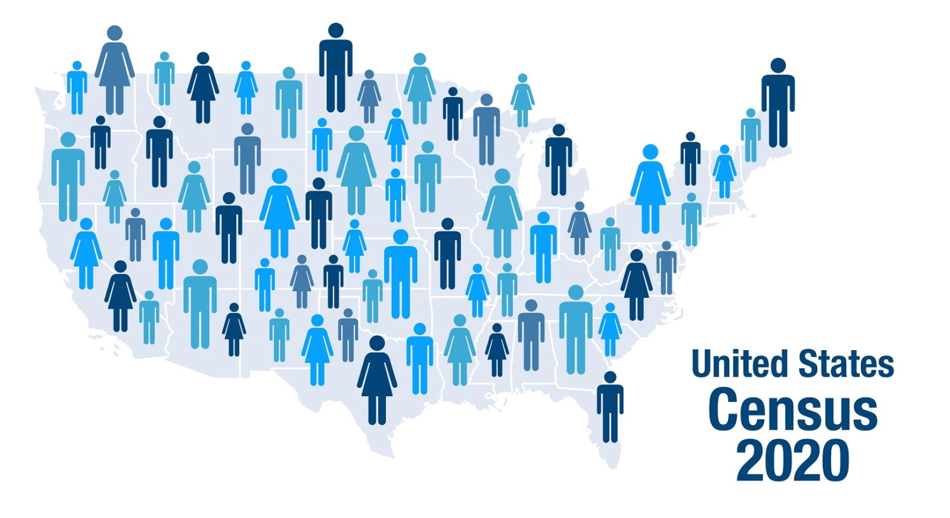
The Supplemental Poverty Measure (SPM) Cash Income – Taxes, Expenses, Cost of Living Improves upon the Official Poverty Measure

Slide 5

Smoking Causes:
Smoking (specifically cigarettes) harms nearly every organ in the body and is the #1 leading cause of preventable death in the US.
Nearly 1 in 5 deaths annually
90% of all lung cancer deaths
80% of all COPD deaths
Stroke and coronary heart disease
Infertility, high risk pregnancy, and birth defects
Arthritis, osteoporosis, diabetes and cataracts
Increased risk of death from all causes

Slide 6
20.2%
Of adults earning less than $35,000 a year are current smokers and are likely to smoke for almost twice as long as those not in poverty.

Slide 7

Research Goals
Explore the relationship between poverty and smoking.
Compare these relationships over time, from 2014-2021.
Assess if geography plays a role in these relationships.

Slide 8
Hypothesis: there will be a strong correlation between rates of poverty and current smokers at both a state and national level.

Slide 9


Data Sources
United States Census Bureau American Community Survey (ACS)
Smoking Data:
The Behavioral Risk Factor Surveillance System (BRFSS)
OPM and SPM State Tables: 2009 to 2019, 2021
Administered by the CDC annually. Examined rates of Current Smokers.

Slide 10
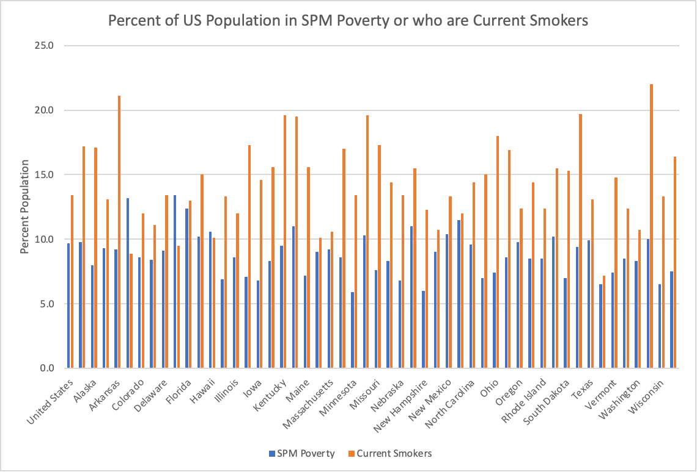
Percent of US Population in SPM Poverty and Current Smokers

Slide 11
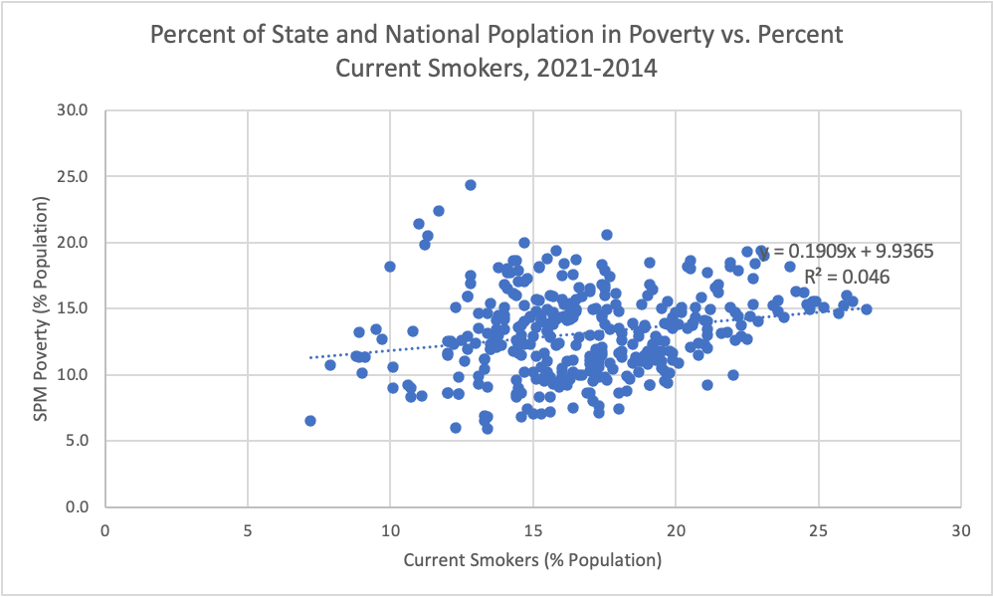
Percent of State and National Population in Poverty vs. Percent Current Smokers, 2021-2014
Notes:
for all years: visually, there is a lot of variance in this data that suggests that while there may be some correlation, there is also a great deal of randomness. Numberically, we observe some positive correlation but with a low R^2 means a weak relationship. this multi-year correlation is far stronger than any one isolated year, however, which all showed very little to no correlation.

Slide 12
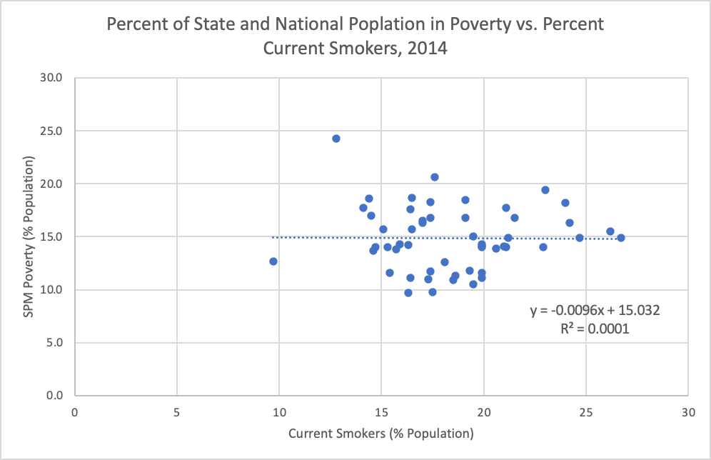
Year-to-Year Analysis: no correlation

Slide 13
Correlation Statistics
 | Percent SPM | Smoking Rate | Years
Percent SPM | 1
Smoking Rate | 0.216704606 | 1
Years | -0.500070588 | -0.340542842 | 1

Slide 14
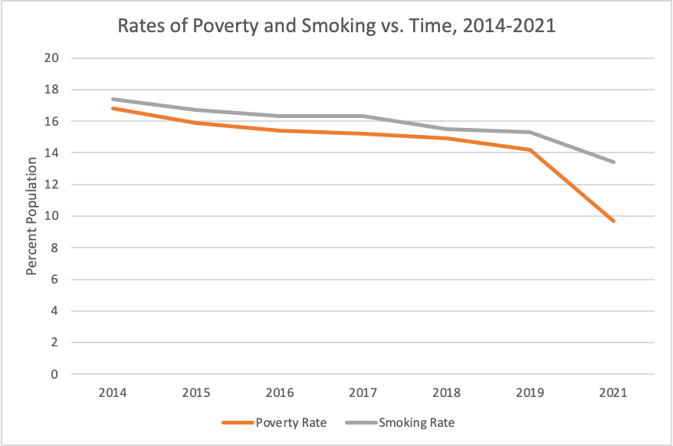
Rates of Poverty and Smoking vs. Time, 2014-2021

Slide 15
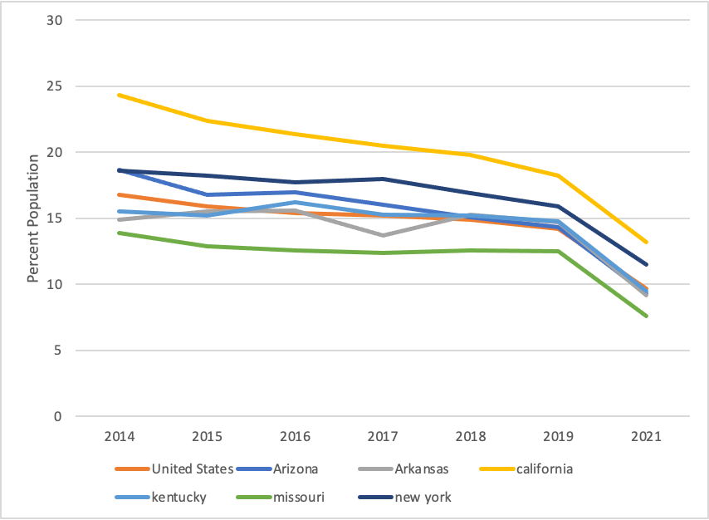
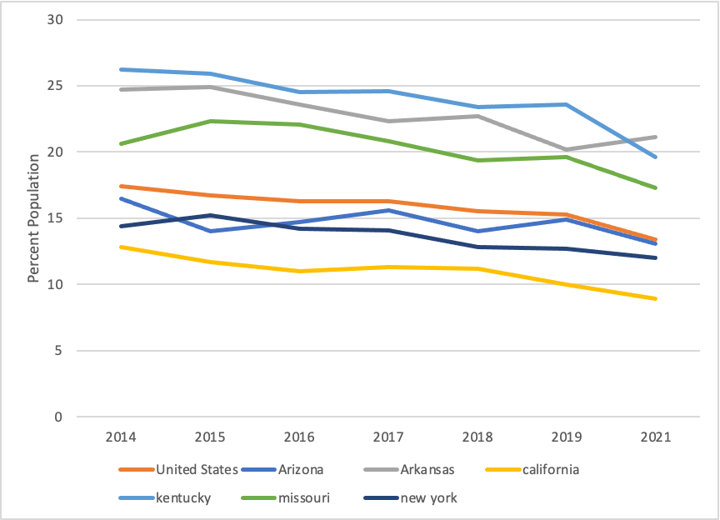
Rates of Poverty and Smoking vs. Time, 2014-2021
Poverty
Smoking

Slide 16
Comparing Correlation Coefficients between the Rates of Poverty and Smoking in Select States, 2014-2021
State | Correlation Coefficient
USA | 0.97038872
Arizona | 0.7493591
Arkansas | 0.52310779
California | 0.96498688
Kentucky | 0.88481733
Missouri | 0.75678727
New York | 0.8347468
Mean: 0.812 ±0.06 Sample Variance: 0.0241

Slide 17
ANOVA Two-Factor without Replication for Comparing Rates of Poverty and Smoking vs. Time in Select States, 2014-2021
ANOVA
Source of Variation | SS | df | MS | F | P-value | F crit
Rows | 300.136327 | 6 | 50.0227211 | 46.197804 | 1.0676E-23 | 2.21723487
Columns | 1387.83918 | 13 | 106.75686 | 98.593847 | 8.5288E-43 | 1.84776338
Error | 84.4579592 | 78 | 1.08279435
 |  |  |  |  | accept H₀
Total | 1772.43347 | 97
Several hypotheses tested here: the null hypotheses H₀ set states that the SPM data does not vary significantly between states or between years and the Smoking data does not vary between states or between years. The alternative H_{a} would negate one or more of these.

Slide 18

Conclusions
There does exist a correlation between states’ rates of people living in poverty and current smokers, in agreement with earlier studies.
Both poverty and smoking have decreased insignificantly between 2014 and 2021, but poverty decreased the most.
Geography plays a major role in controlling the strength of these correlations.

Slide 19

Potential Implications
Smoking cessation programs
focus on addressing poverty and other SDOH
tailor to community location

Slide 20
References
https://health.gov/healthypeople/priority-areas/social-determinants-health
https://www.aafp.org/about/policies/all/poverty-health.html#:~:text=Poverty%20affects%20health%20by%20limiting,an%20individual%27s%20standard%20of%20living.
https://www.census.gov/topics/income-poverty/supplemental-poverty-measure/about.html
https://www.cdc.gov/tobacco/data_statistics/fact_sheets/health_effects/effects_cig_smoking/index.htm
https://www.lung.org/research/sotc/by-the-numbers/top-10-populations-affected
Siahpush M, Singh GH, Jones PR, Timsina LR. Racial/Ethnic and Socioeconomic Variations in Duration of Smoking: Results from 2003, 2006 and 2007 Tobacco Use Supplement of the Current Population Survey. Journal of Public Health 2009;32(2):210-8.
U.S. Census Bureau, 2009 through 2019 and 2021 American Community Survey Public Use 1-year estimates. https://www.census.gov/data/tables/time-series/demo/supplemental-poverty-measure/ACS-SPM-State-Tables.html
https://nccd.cdc.gov/weat/#/crossTabulation/selectYear

Slide 21
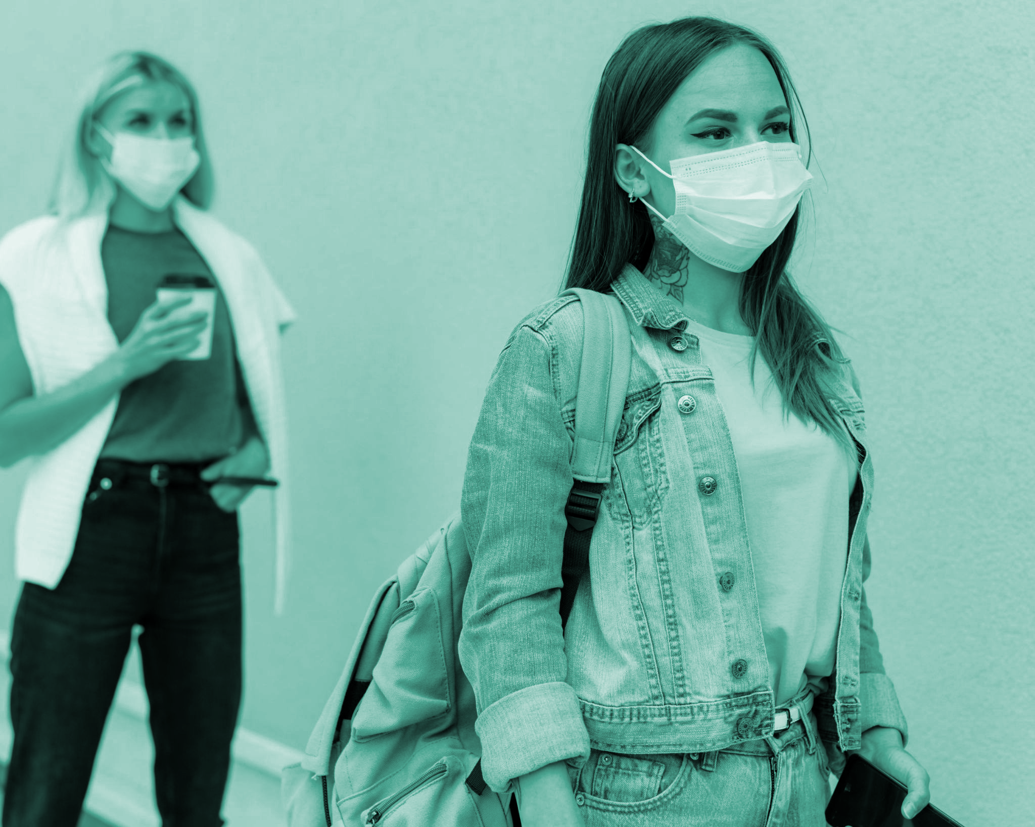
Thanks!
Do you have any questions? youremail@freepik.com | +34 654 321 432 yourwebsite.com
Please keep this slide for attribution

